Slide 1

Young Devin Winters has just heard his bedtime story and falls asleep.

Slide 2

His dream however is a restless one.

Slide 3
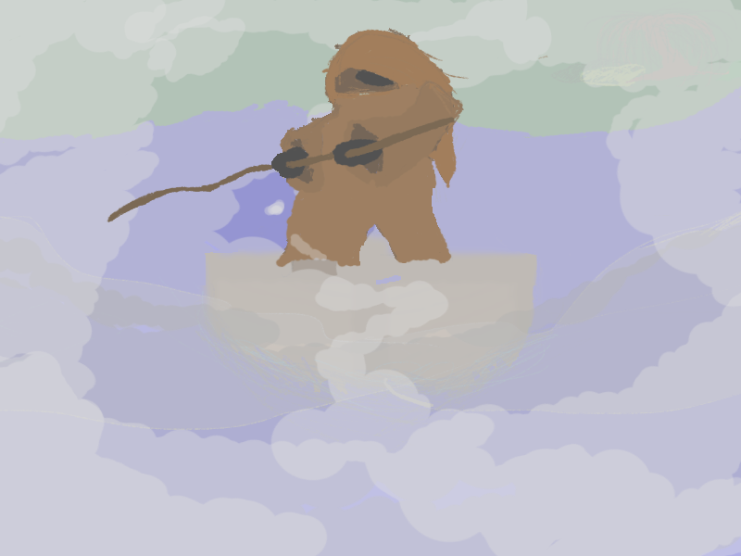
A ferryman emerges from the morning dawn. He slowly approaches a young boy sleeping on the riverbank and suddenly realizes from a vague memory who this young boy is.

Slide 4

The ferryman wakes up Devin and tells him he is the dreamkeeper: the prophesied saviour of the dreamworld. He tells Devin about the growing void and how he is supposed to stop it.

Slide 5
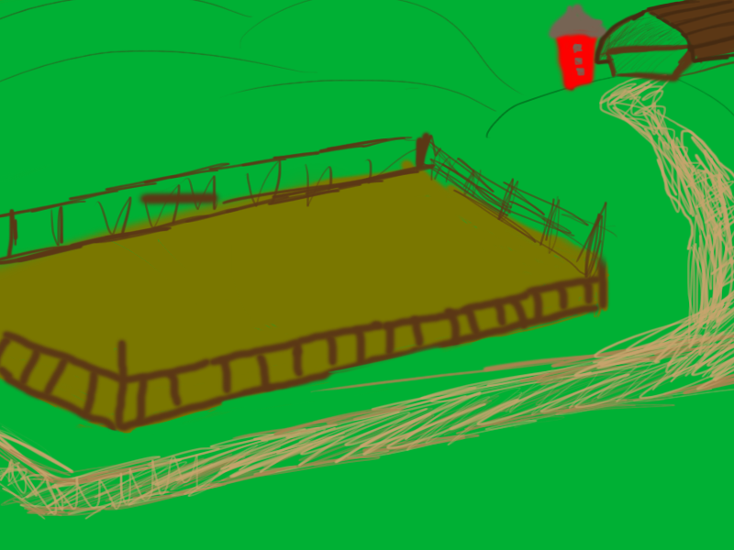
Level 2 - The Farmer
The second person to save from his troubled mind is the farmer. His crops are being destroyed by a plague of grasshoppers and Devin is the one to drive them away. When the farmer wakes up he thanks you and rewards Devin with binoculars.

Slide 6
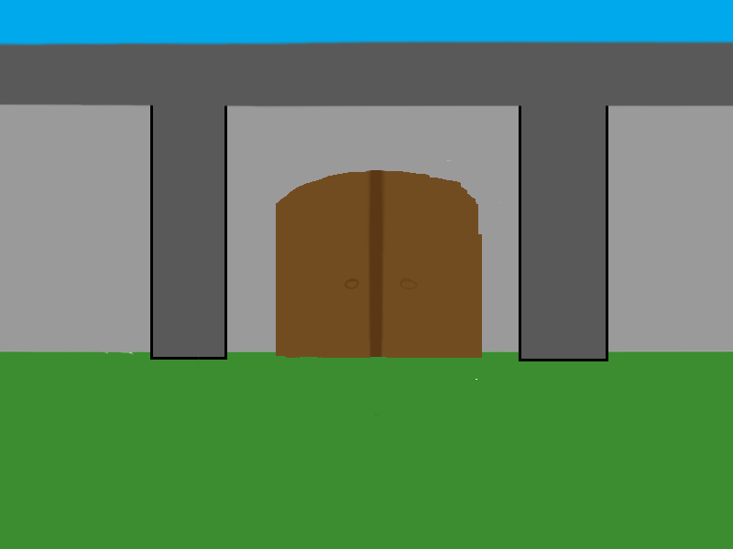
Level 3 - The Guard
In his nightmare the gatekeeper has grown blind while he is the one that should spot and scare away intruders. Devin takes the previously acquired binoculars and uses it to spot the intruders so that the gatekeeper can scare them away. After helping the guard he gives you acces to the town.

Slide 7
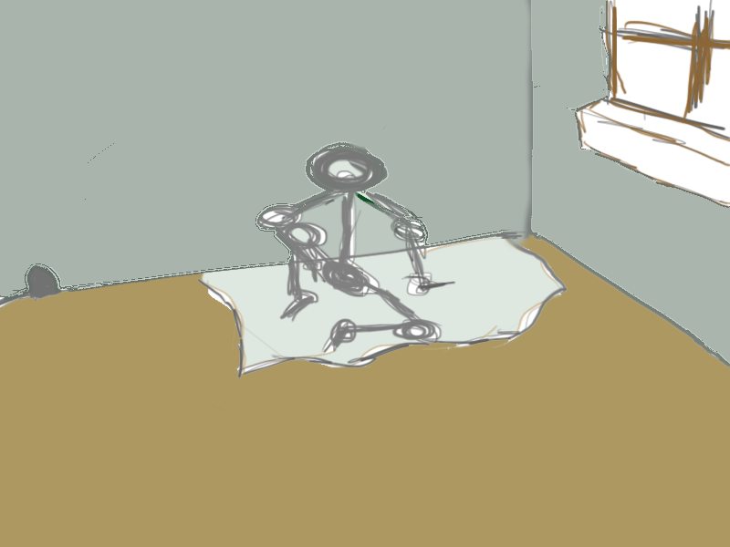
Level 4 - The Hobo
Having gained acces to the city the first impression is not a great one. Devin sees a Hobo sleeping in the corner of a street. He enters his dream and sees the hobo scared in a corner while a pack of rats is stealing his food. Having saved the hobo Devin is rewarded with a strange stone.

Slide 8
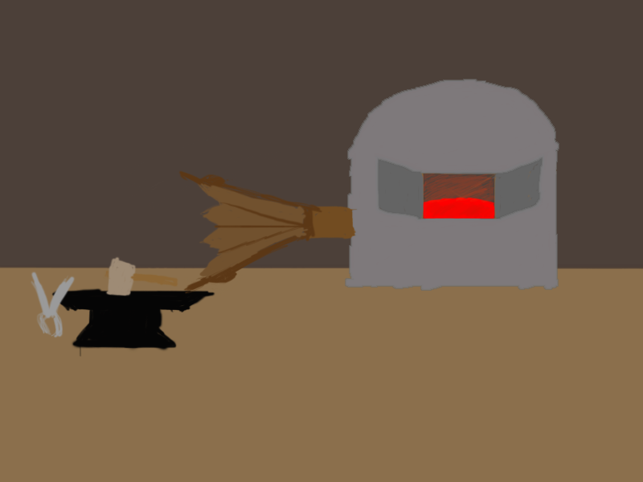
Level 5 - The Blacksmith
The blacksmith is being attacked by his own armours brought back to life by a mysterious magic curse. You save him and rewards you by melting the strange stone into small silver balls.

Slide 9
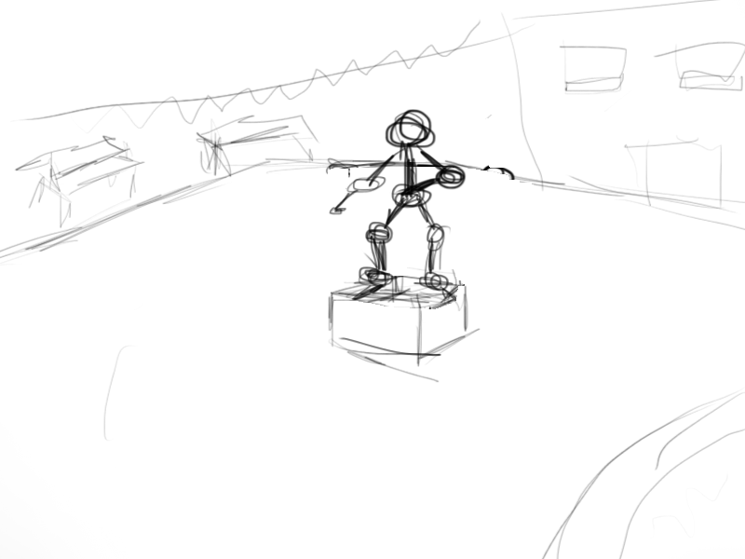
Level 6 - The doomsayer
The doomsayer is nightmare is screaming that the heaven will fall down. Before you know it a meteorite makes a huge crater a quater mile away. From the meteorite spawn aggresive aliens. Devin protects the doomsayer and is rewarded with a strange letter.

Slide 10
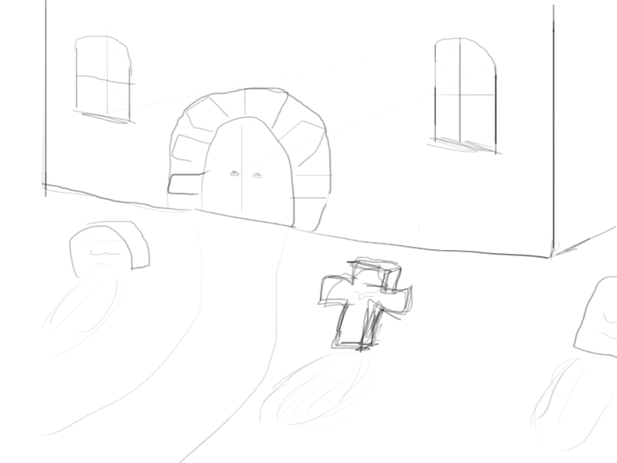
Level 7 - The Priest
You give the strange letter from the doomsayer to the priest to clarify it. The letter appeard to contain a strange spell spawning void demons. The priest swiftly gave you a flask of holywater and asks you to protect the church.

Slide 11
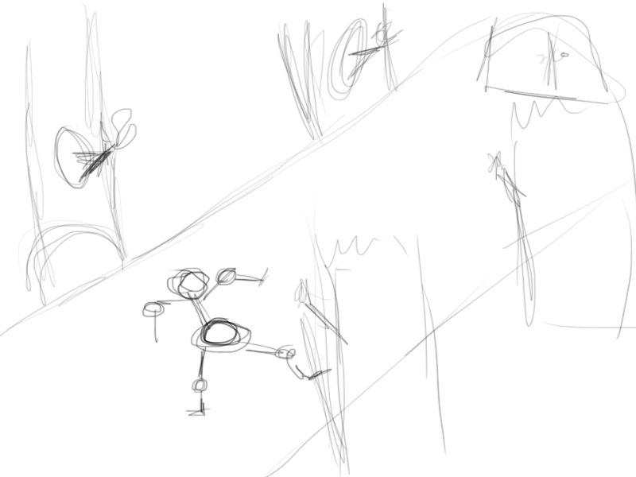
Level 8 - The Jester
The jester is being tortured by posses Jack-in-a-Box's . You defend him from them and the jester show you a secret passageway to reach the king.

Slide 12
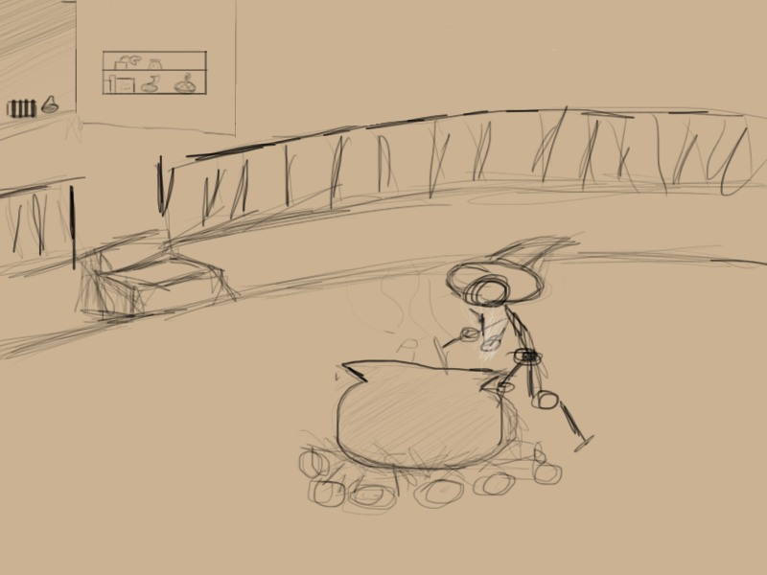
Level 9 - The Court Mage
The court mage's powers are being blocked by void minions. Devin drives them away to protect the mage Aftersaving him the mage quickly gives you the keys to the throne room so you can go and save the king.

Slide 13
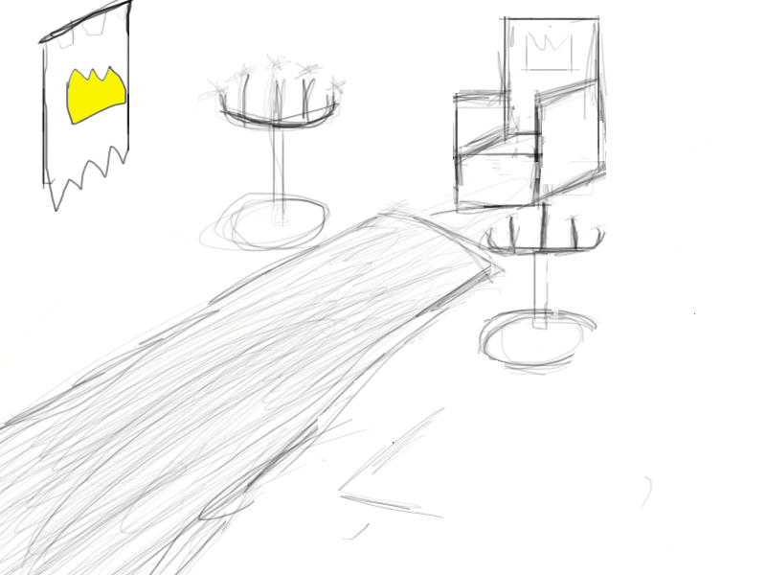
Level 10 - The king
The void has already reached the king and the voiddemons have captured the king. Devin saves him from their grasp and in the process he destroys the Void completely(or so it seems).

